Slide 1
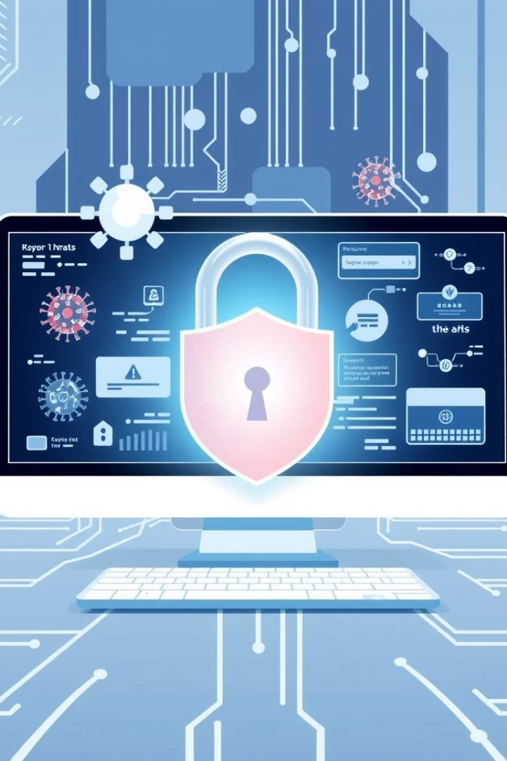
Phishing Awareness Training: Don't Get Hooked!
Protecting our organization from cyber threats is crucial. This training will help you recognize and avoid phishing attempts.
by AATHIRAJ V

Slide 2
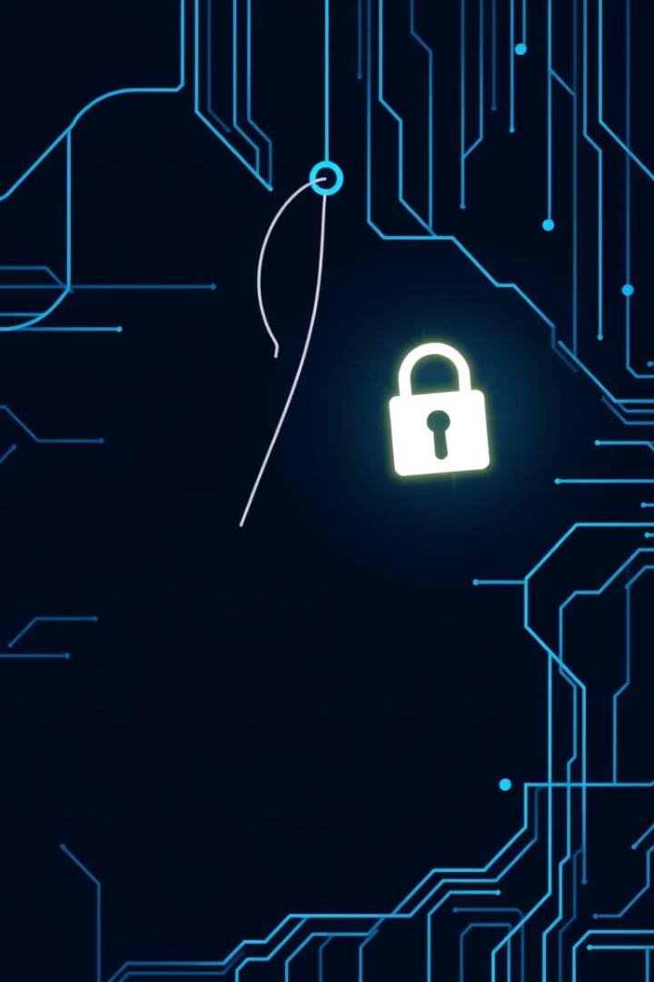
What is Phishing?
Deceptive Cybercrime
Phishing uses misleading emails or websites.
Stealing Information
It aims to steal sensitive data like passwords.
Major Impact
Leads to financial loss, breaches, and reputation damage.
Widespread Affect
667 million individuals were affected in 2023.

Slide 3

Why Phishing Matters
90%
$4.45M
Breaches Start
Average Breach Cost
90% of data breaches begin with phishing.
Data breaches cost millions on average.
61%
Attacks Increased
Phishing attacks rose significantly in 2023.
Our company is a target; protecting our data is vital.

Slide 4
Spotting Phishing Emails
Urgent Language
Suspicious Links
Beware of "act now" or threatening messages.
Always hover over links to check destinations.
Grammar Errors
Mismatched Senders
Unprofessional emails often have mistakes.
Verify domain names of senders carefully.
Generic Greetings
Impersonal salutations are a common sign.

Slide 5
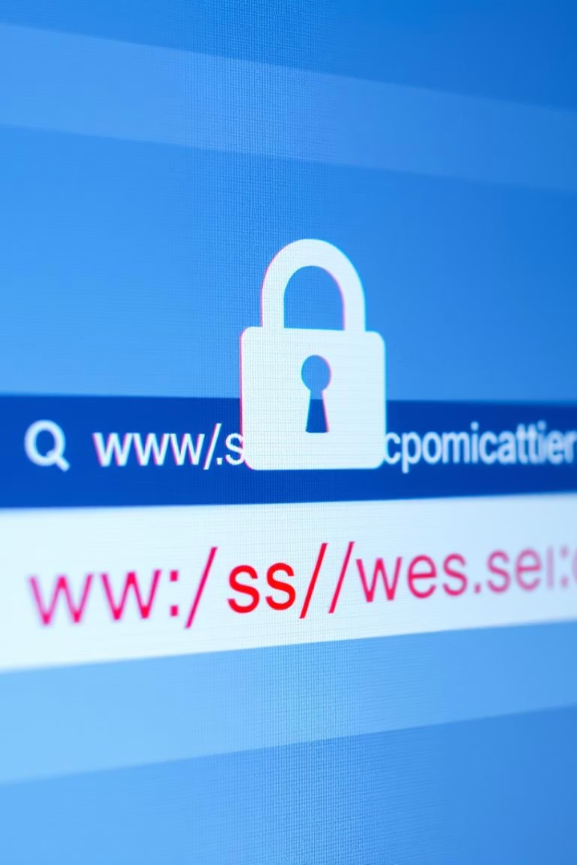




Recognizing Fake Websites
Check the URL
Verify Security
Inspect Design
Look for misspellings or odd variations.
HTTPS with a padlock icon is essential.
Poor layout and low-res images are red flags.
Confirm Contact
Ensure valid address and phone number.

Slide 6

Social Engineering Tactics
Pretexting
Baiting
Impersonating trusted figures to gain confidence.
Luring victims with promises of free goods or services.
Fear-Mongering
Creating panic to rush decisions. Examples: "Your account will be suspended!" or "Urgent security alert!"

Slide 7
Best Practices: Avoid the Bait
Don't Click Links
Always verify the source first.
Enable MFA
Multi-Factor Authentication adds extra security.
Verify Requests
Confirm sender's identity via phone or in person.
Keep Software Updated
Patch security vulnerabilities regularly.
Report Phishing
Notify IT or the security team immediately.

Slide 8
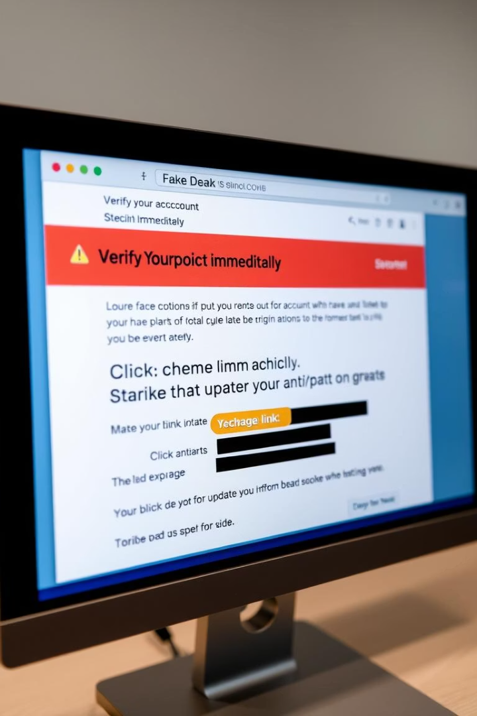
Real-World Phishing Example 1: Fake Bank Email
Subject
"Urgent: Verify Your Account Details"
Contains
Official-looking logo, link to fake login page.
Goal
Steal bank login credentials and access funds.
This email aims to trick you into revealing your banking information.

Slide 9

Real-World Phishing Example 2: Bogus Amazon Email
Subject
"Your Package Could Not Be Delivered"
Contains
Shipping notification, request for payment details.
Goal
Obtain credit card information for fraudulent purchases.
Be wary of unexpected delivery notifications asking for financial information.

Slide 10




Interactive Quiz: Test Your Knowledge!
Question 1
What's the first thing you should do if you suspect a phishing email?
Question 2
What does HTTPS in a URL indicate?
Question 3
What is Multi-Factor Authentication (MFA)?
We'll provide answers and explanations after each question.

